Slide 1
Process Selection
Process selection is about deciding on the way production of goods and services will be organized
Influences the capacity planning, layout of facilities, and work design
Process selection is demand driven
Process strategy: key aspects
Capital intensity
Process flexibility

Slide 2
Process Selection: Key Questions
How much variety needed?
How much volume needed?

Slide 3
Types of Processes
Job Shop
Low volume - high variety products
Batch
Moderate volume of products with a moderate variety
Repetitive
Higher volume of more standardized products
Continuous
Very high volume of non-discrete and highly standardized output
Project
non-routine work, with a unique set of objectives to be accomplished in a limited time frame

Slide 4
 | High variety | Moderate variety | Low variety | Very low variety
Low or very low volume | Job shop 1. Operating room 2. Garage
Moderate volume |  | Batch Soft drinks Shoes Classroom lecture
High volume |  |  | Repetitive Engine assembly line Automatic car wash
Very high volume |  |  |  | Continuous flow Petroleum refining Steel production

Slide 5
Types of Processes
 | Job shop | Batch | Repetitive | Continuous
Product nature | Customized | Semi-standardized | standardized | Highly standardized
Advantages | Highly flexible; handles wide variety of work | Flexibility; easy to add or change products | Handles high volume; efficient | Handles very high volume; highly efficient
Disadvantages | High flow time; high complexity in scheduling | Moderate complexity in scheduling | Low flexibility; High cost of downtime | Lack of variety; Very high cost of downtime

Slide 6
Facility Layout
Layout refers to the configuration of departments, work centers, and equipment with particular emphasis on movement of work (customers or materials) through the system
Needed for both new facilities and redesigning existing facilities
Layout decisions are important for the following reasons:
Require substantial investment of money and effort
Involve long-term commitments
Significant impact on the cost and efficiency of operations

Slide 7
Objective of Layout Design
Basic objective:
To facilitate a smooth flow of work, material, and information through the system
Supporting objectives:
To facilitate attainment of product quality
To use workers and space efficiently
To minimize material handling cost
To eliminate unnecessary movements of workers and materials

Slide 8
Facility Layout
Product layout
Process layout
Fixed position layout
Hybrid layout

Slide 9
Facility Layout
1. Product layout (repetitive processing)
Used to achieve a smooth and rapid flow of large volumes of goods or customers through a system
Made possible by standardizing goods or services that allow standardized and repetitive processing
Achieves high degree of labor and equipment utilization
Requires high investment for dedicated lines

Slide 10
Facility Layout
1. Product layout (repetitive processing)
Advantages | Disadvantages
High rate of output | Division of labor leading to dull and repetitive jobs
Low unit cost due to high volume | Fairly inflexible system
Labor specialization | Susceptible to shutdowns
Low material handling cost | No skill development for worker
High utilization of labor and equipment | Worker motivation through incentives is impractical

Slide 11
Designing the Product Layout
Line balancing
The objective of product layout is to have smooth flow of work in an assembly line
A process is composed of many tasks (activities)
Line balancing is the process of deciding how to assign tasks to workstations
The goal of line balancing is to group tasks in workstations which require similar time duration
Balanced lines improve the labor and equipment utilization
Key question: How many workstations needed?

Slide 12
Line Balancing
The number of workstations required is primarily dependent on the cycle time of the line
Cycle time
The time between the successive product completions
The maximum time allowed at each workstation to complete the respective assigned tasks at each workstations
Cycle time is decided by the output rate
Cycle time will decide on the theoretical number of workstations required

Slide 13
Line Balancing
Once the cycle time is decided, then allocate the tasks to the workstations
For assigning the tasks, one should know the order in which the tasks are carried out, which is given by precedence diagram
Precedence diagram
A diagram that shows elemental tasks and their precedence requirements
Gives the order in which tasks are performed
The choice of selecting the task from the eligible and will fit set for workstations is based on heuristics.
Eligible set is given by the precedence diagram
Will fit set is a subset of eligible set and is based on the time available in a workstation

Slide 14
Line Balancing
One of such heuristics is ranked positional weight algorithm
Select the task having the highest positional weight
Positional weight of a task is the sum of the task times of that task and its following tasks
After a task has been assigned to a workstation, remove that from consideration
When a workstation cannot take anymore assignments, continue to the next workstation
Continue the procedure until all tasks have been assigned
Count the number of workstations used, which is the actual number of workstations.

Slide 15
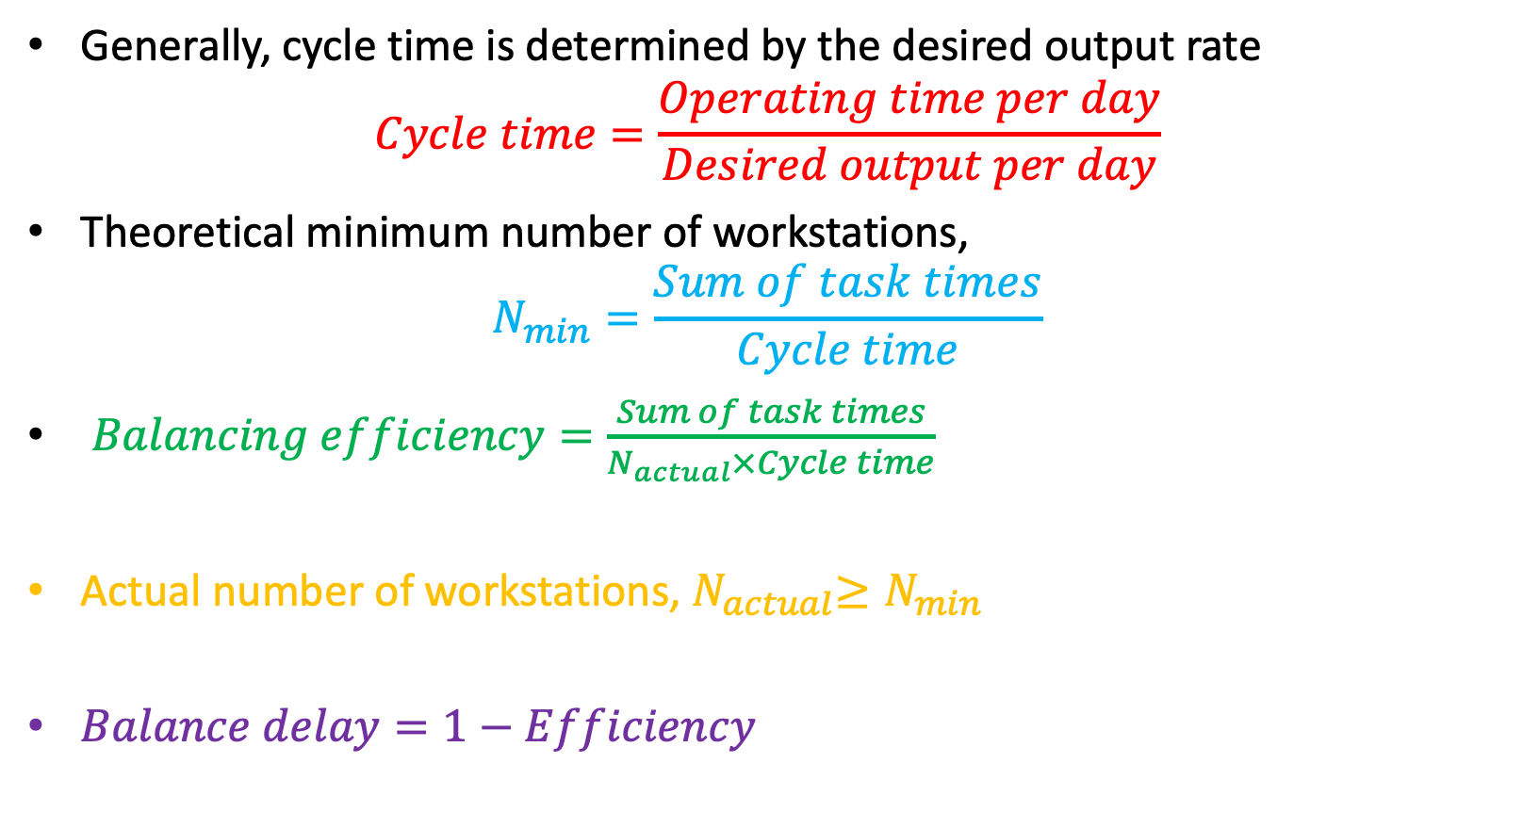
Line Balancing
Generally, cycle time is determined by the desired output rate
$$Cycle time=\frac{Operating time per day}{Desired output per day}$$
Theoretical minimum number of workstations,
$$N_{min}=\frac{Sum of task times}{Cycle time}$$
$Balancing efficiency=\frac{Sum of task times}{N_{actual}×Cycle time}$
Actual number of workstations,${ N}_{actual}≥N_{min}$
$Balance delay=1−Efficiency$

Slide 16
Example
Balance the assembly line of a printer with the task, their relationships, and respective times given the table below. The management is designing the line to produce an output of 275 units per day. The line will operate for 440 minutes in a day.
Task | Immediate predecessor | Task time (minutes)
A | - | 0.3
B | - | 0.6
C | A | 0.4
D | B | 1.2
E | C | 0.2
F | D | 0.6
G | E | 0.1
H | G,F | 0.5
I | H | 0.3

Slide 17
Facility Layout
2. Process layout (non-repetitive processing)
Designed to process items or provide services that involves a variety of processing requirements
Variety of jobs processed implies discontinuous work flow
Layout features functional grouping

Slide 18
Facility Layout
2. Process layout (non-repetitive processing)
Advantages | Disadvantages
Handles a variety of processing requirements | Work-in-process inventory can be high
Less vulnerable to shutdown | Equipment utilization rates are low
Possibility of implementing individual incentive systems | Scheduling and routing are complex
Labor skill development | Costly material handling

Slide 19
Facility Layout
3. Fixed position layout
Items being worked on remain stationary
The resources, i.e., workers, equipment, and material move to the item being worked
Weight, size, or some other factors make the item to be worked in a fixed position
Used in ship building, construction projects, large aircrafts etc.

Slide 20
Facility Layout
3. Fixed position layout
Advantages | Disadvantages
Low fixed cost of equipment (as it could be rented) | High variable cost (cost of labor and leasing the equipment)
No movement of the item to be worked | Equipment utilization rates are low
Useful when the item to be worked cannot be moved | High administrative burden

Slide 21
Facility Layout
4. Hybrid layout: cellular layout
Attempts to combine the flexibility of a process layout and efficiency of a product layout
Workstations are grouped into a cell
Grouping are determined by the operations needed to perform work for a set of similar items, i.e., part families
Using Group technology, dissimilar machines are placed in cells to process families of parts which require similar operations
The layout within a cell resembles a product layout
The layout between cells resembles a process layout

Slide 22
Facility Layout
4. Hybrid layout: cellular layout
Advantages | Disadvantages
Reduced material handling and setup time | Inadequate part families
Reduced WIP inventory | Poorly balanced cells as items may follow different sequences
Better utilization of labor | Increased capital investment
Easier to control and automate | Scheduling the workforce

